Slide 1


EXPLORATORY DATA ANALYSIS
REVIEW 3: Employee Attrition and Performance
Using
Exploratory Data Analysis
Submitted By :
SADHANA C (Reg. No.: 20MDT0022)
YAMINI PRIYANKA K (Reg. No.: 20MDT0024)
SAKTHIVEL M (Reg. No.: 20MDT0045)
M.Sc. Data Science (MDT)

Slide 2
Under the Supervision of
Dr . B. RUSHI KUMAR
Assistant Professor (Senior)
Department of Mathematics
School of Advanced Sciences
VELLORE INSTITUTE OF TECHNOLOGY
VELLORE – 632 014
TAMIL NADU
INDIA
MAY 2021

Slide 3
OBJECTIVE
This project objective is to predict the rate of attrition for every worker, to seek out who’s a lot of probably to go away the organization.
It'll facilitate organizations to seek out ways that to stop attrition or to set up before the hiring of latest candidate.
Attrition proves to be a expensive and time intense downside for the organization and it conjointly ends up in loss of productivity.
The scope of the project extends to firms altogether industries.

Slide 4
ABSTRACT
Attrition of employee become an unsolved problem today before looking over it let us clear you about what is Employee Attrition. Employee Attrition is nothing but few employees will leave the company due to retirement, less satisfaction in work, over work load, low salary package, stress fullness, family situation, work background, etc., Where a company could save money and time by having a valuable employees with them. Before days. This work process was handled by HR department of the companies. They will take care of selecting the employees in interviews, having the clear cut data about employees and even they know why employees leave the company. In order to prevent others resignation in future. And, Now a days we are having advanced solution to solve this kind of issues which is nothing but Data Science Techniques to prevent companies from attrition where, totally it was handled by manager of the companies to get information about employees in a faster and efficient way when compare to traditional work done by HR department. The dataset we are using is IBM HR Analytics Employee Attrition and Performance dataset taken from KAGGLE. It is used to watch the trends related to Employee Attrition Using python and EDA (Exploratory Data Analysis) concepts we would try to uncover factors that might be related to attrition levels among the employees. This results will definitely maximize the Companies revenue.
Keywords: Statistical Data Analysis, Exploratory Data Analysis, Soft Computing Algorithms, Attrition of employee, Prediction Analysis, Outliers Identifications, Heat Map.

Slide 5
APPROACH
Check for NULL values in the data set and doing preprocessing which is nothing but cleaning the dataset.
Our target is to understand the features that how they are related to our targeted variable attrition.
Convert Categorical targeted variable into numeric form from the given dataset
Apply feature selection applied to make model.
Apply various EXPLORATORY DATA ANALYSIS TO UNDERSTAND the dataset in more depth.
Draw out the OUTPUT that we get.

Slide 6
DATA SOURCES
The name of this project is ‘IBM HR Analytics Employee Attrition & Performance’, has been picked, which is available on IBM website.
The data contains rows of 1,470 employees.
INFORMATION that it contains as attribute way current distance from home, monthly income, employment status, Total number of years at the current company and the current roles, Their education level, the total number of companies worked for in the past, etc.

Slide 7
Tools and techniques
We have took ANACONDA JUPYTER Python as our analytics tool.
Python includes some packages like Pandas, NumPy, Matplotlib, Seaborn, sklearn, etc.
Importing the Libraries which contains in-build function
IMPORTING LIBRARY AND DATA EXTRACTION
EDA for Data Extraction and to visualize the dataset in clear form.

Slide 8
INTRODUCTION
Employee steady loss( i-e attrition) may be a decreases in man control in any organization where workers may willfully take off the organization or could be surrendered. Representative i-e is employee turnover is the number of existing specialists exchanged by modern workers for a particular period. A high steady loss causes tall specialist turnover in any organization. This in this way causes tremendous use on human assets, by contributing towards modern enrolment, preparing and enhancement of the naturally enlisted specialists, likewise the execution administration. Once more, whittling down which are of deliberately unavoidable. From this time forward, by improving representative resolve and giving a alluring working conditions, ready to obviously diminish this issue fundamentally. The rate of whittling down is characterized as the enrolment and end criteria of the organization. An employee can take off the work for distinctive clarification. Here, the 'Turnover' and ‘work steady loss' are the trade wordings that always clashes each other. There are diverse sorts of 'turnover

Slide 9
There are diverse sorts of 'turnover' in a company. Bringing down in number of employees is for the most part considered as the ‘work steady loss i-e attrition'. To examine the man control and other estimations that are crucial for labor arranging these wordings can be alternately utilized. At the point when an representative takes off the organization both whittling down and turnover happen.
Turnover, in any case happen due to diverse work exercises, for instance, discharge, end, surrender or on the other hand occupation yield. Whittling down happens when a specialist leaves or when the affiliation takes out his occupation. The differentiation between the two is that when turnover happens, the affiliation looks for somebody to supplant the employee. In illustrations of whittling down, the commerce takes off the opportunity unfilled or clears out that commerce work. Predicting representative steady loss at an organization will empower management to act faster by overhauling their internal policies and procedures.

Slide 10
Contd..
Where gifted workers with a risk of taking off can be advertised some proposals, for example, a pay increase or appropriate preparing, to decrease their probability of clearing out. Utilizing machine learning models can help organizations to expect worker steady loss. Utilizing the historical information kept in human assets (HR) offices, analysts can construct and get ready a machine learning show that can foresee the laborers who are taking off the organization. Such models are arranged to see at the connection between the highlights of both dynamic and terminated specialists. This paper is composed as takes after EXPLORATORY DATA ANALYSIS CONCEPTS TO UNDERSTAND THE DATASET MORE DETAILEDLY USENG SOME, Statistical Data Analysis, Exploratory Data Analysis, Soft Computing Algorithms, Attrition of employee, Prediction Analysis, Outliers Identifications, Heat Map, Bar plot, Pie chart, SNS, etc.

Slide 11
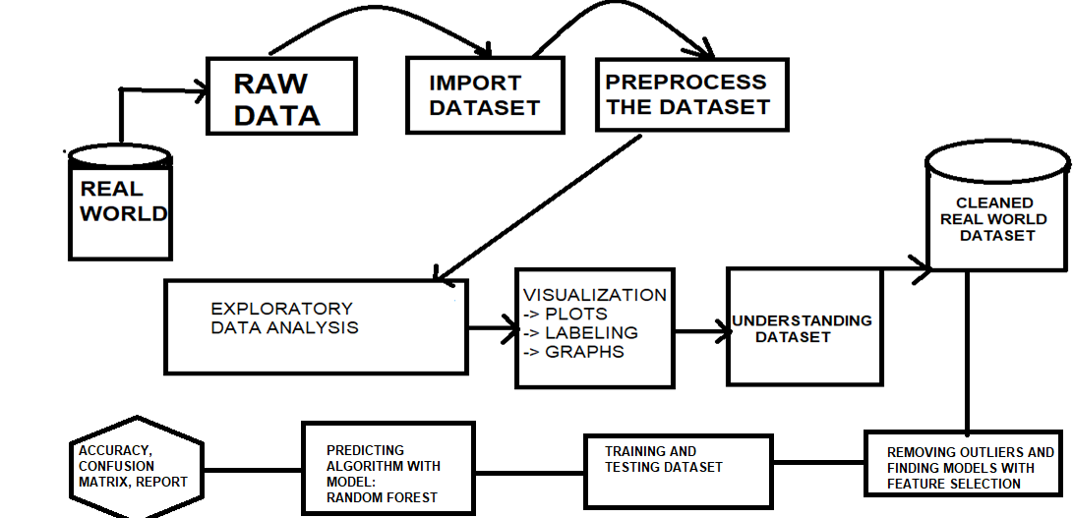
PROCESS CHART

Slide 12
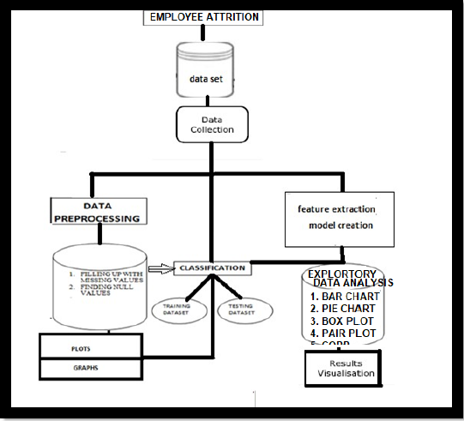
EDA ARCHICTECTURE FOR EMPLOYEE ATTRITION

Slide 13
LITERATURE REVIEW
Sri Harsha, A. Jithendra Varaprasad, L.V N Pavan Sai Sujith (2020) EARLY PREDICTION OF EMPLOYEE ATTRITION
Few fundamental Exploratory Information Investigation to highlight engineering as well as executing learning models within the form of a Arbitrary Timberland returns an 85% accuracy in its predictions. The elemental common clarification for whittling down is in all likelihood the effort-reward awkwardness. For this circumstance, this for the foremost portion applies to people who are remaining at work longer than required and who much of the time have a for the most part moo pay - it need to be checked whether there's a compelling additional time methodology in our organization. We have moreover found that different highlights of work-life adjust may talk to an issue for our agents (a finding supported by discernments and (in any occasion to some degree) our best calculation).

Slide 14
LITERATURE REVIEW
In 2016, Raja and Kumar assessed the circumstances that impact representative whittling down within the IT division. They utilized a survey for information gathering with a sample of 300 specialists within the IT division.
The disobedient they utilized are basic rate strategy, chi-square method, and relationship coefficient method.
They found hat there's no relationship between components that hold the worker within the IT division and the components that impact the representative work environment.
Bindra, Sehgal, and Jain, analyzed Representative Whittling down information to foresee the representative steady loss based on five classes.
They utilize the Association Run the show Calculation ‘Apriori’ and Choice Tree Calculation ‘C5.0’. The conclusion is that the performance of the calculation is expanded when they utilize C5.0 with the affiliation run the show calculation as compared to utilizing C5.0 freely [6]. In 2016, Mishra and Lama proposed a demonstrate to make strides the effectiveness and execution of the Human Asset framework that will optimize commerce results by providing a system for Human Asset decision-making related choices comprising information mining and prescient analytics

Slide 15
LITERATURE REVIEW
Nagadevara et al, (2008), explored the relationship of withdrawal hones like delay and non-attendance, work content, residency and socio-economics on specialist turnover in a rapidly creating fragment just like the Indian computer program industry. The exceptional portion of this investigate was the utilization of five prescient information mining methods (fake neural systems, calculated relapse, classification and regression trees, classification trees (C5.0), and discriminant analysis) on a test information of 150 worker in a expansive software organization.
The results of the inquire about clearly illustrate a association between withdrawal behaviours and employee turnover.
This think about raised many issues for future inquire about. To begin with, encourage investigate could explicitly gather information on measurement variables over a huge sample of organizations to examine the association between statistic components and turnover.
Moment, expansive scale information on variables within the past scholastic investigate which have an collected In an exposition by Marjorie Laura Kane-Sellers (2007), the researchers did an examination to investigate the variables affecting laborer deliberate turnover within the North American professional deals drive of a Fortune 500 mechanical manufacturing firm. By considering Intentional Turn Over, the desire was to extend a prevalent understanding of Human Asset Improvement intercessions that seem improve worker maintenance. The central firm gave perceptions of the laborer database for all people from the master specialized deals control over a 14-years longitudinal period. The primary database passed on 21,271 discrete perceptions recognized by interesting worker clock number

Slide 16
PROBLEM FORMULATION
Correlation plot would be nice
Can we visuvalise the dataset? Can get some feature importances.
What role does gender and age play in this workplace?
How much does income matter?
Are more educated people more likely to leave?
Which Education Field is more likely to leave?

Slide 17
PROBLEM FORMULATION
Does the source of the employee matter? Which website produces the best employees?
Is Job Level equivalent to performance? Can we create a feature to measure this?
Is there a difference in gender?
People who live more than 25 minutes away from work tend to be less happy than those who don't. Lets see whether this is the case.
What sources are best for high performing employees?
What factors contribute to retaining high performing employees?
How does satisfaction and work-life balance relate to employee retention?
How many new hires leave in less than a year and why?

Slide 18
USES CASE
This use case takes HR data and uses machine learning models to predict what employees will be more likely to leave given some attributes. Such model would help an organization predict employee attrition and define a strategy to reduce such costly problem.
The input dataset is an Excel file with information about 1470 employees. For each employee, in addition to whether the employee left or not (attrition), there are attributes / features such as age, employee role, daily rate, job satisfaction, years at the company, years in current role, etc.
The steps we will go through are:
Data preprocessing
Data analysis
Model training
Model validation
Model predictions
Visualization of results

Slide 19
EXPLORATORY DATA ANALYSIS
Refers to the process of performing initial investigations on the data so as to discover patterns, to spot inconsistencies, to test hypothesis and to check assumptions with the help of graphical representations
GRAPHICAL APPROACHES LIKE,
BOX PLOT
CORRELATIONS
COUNT PLOT etc.,

Slide 20
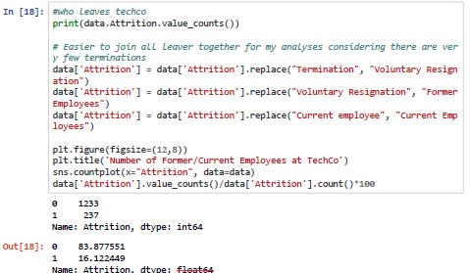
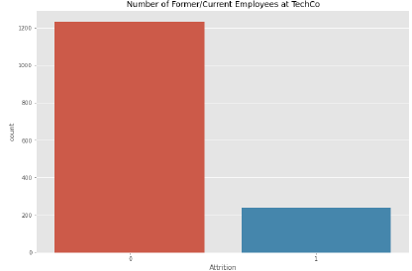
Count plot no. of former vs current emp

Slide 21
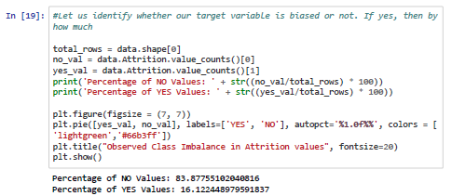
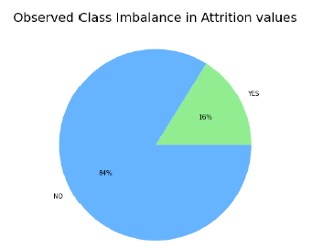
PIE CHART

Slide 22
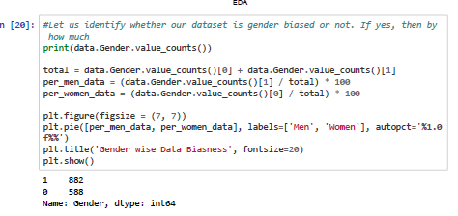
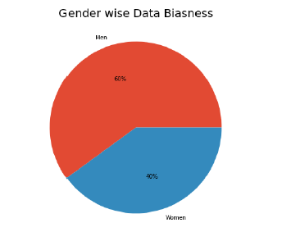
GENDER WISE BIAS NESS

Slide 23
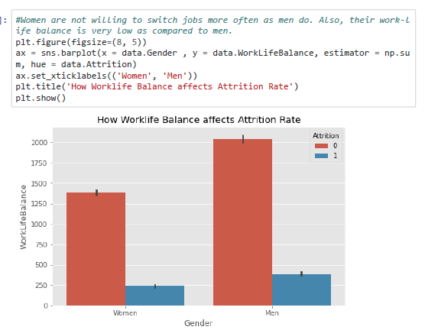
GENDER VS WORKLIFE BALANCE VISULAIZATION

Slide 24
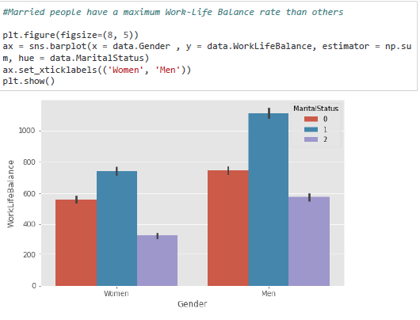
MARITAL STATUS BASED VISUALIZATION

Slide 25
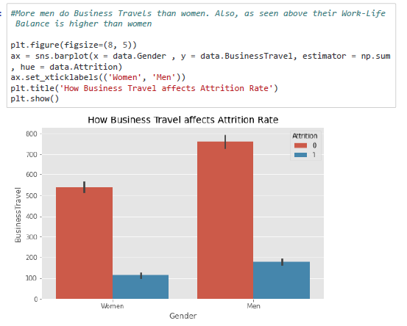
BUSINESS TRAVEL AFFECT ATTRITION

Slide 26
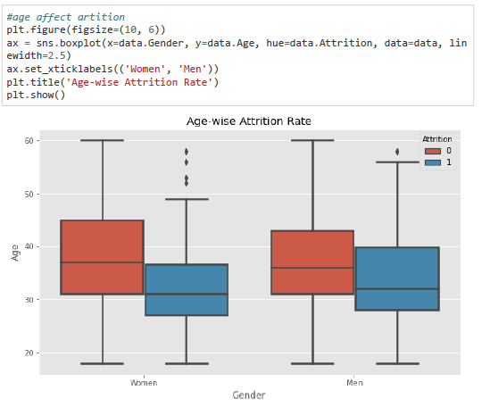
BOX PLOT OF AGE AFFECT ATTRITION

Slide 27
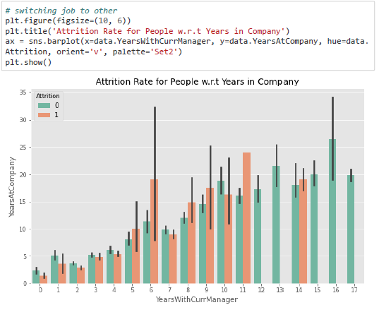
SWITCHING JOBS WITH BAR PLOTS

Slide 28
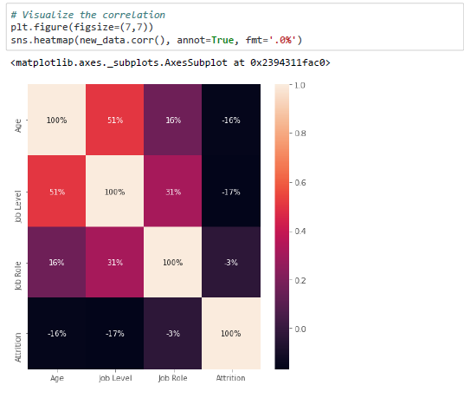
CORRELATION OF DATASET
Correlation is a statistical technique which determines how one variables moves/changes in relation with the other variable.
It’s a bi-variant analysis measure which describes the association between different variables. Usefulness of
Correlation matrix –
1. If two variables are closely correlated, then we can predict one variable from the other.
2. Correlation plays a vital role in locating the important variables on which other variables depend.
3. It is used as the foundation for various modeling techniques.
4. Proper correlation analysis leads to better understanding of data.

Slide 29
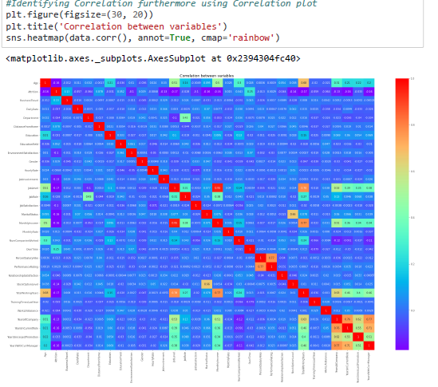
TOTAL DATASET CORRELATION

Slide 30
DATA PREPROCESSING
Steps Involved –
Taking care of missing data and dropping non-relevant features
Feature extraction
Converting categorical features into numeric form Binarization of the converted categorical features
Feature scaling
Understanding correlation of features with each other
Splitting data into training and test data sets
Refers to data mining technique that transforms raw data into an understandable format
Useful in making the data ready for analysis

Slide 31
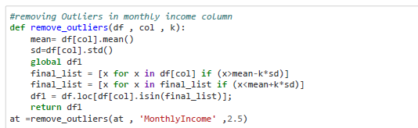
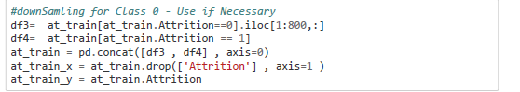
OUTLIER REMOVING
Downsampling is a mechanism that reduces the count of training samples falling under the majority class. As it helps to even up the counts of target categories TO HANDLE IMBALANCED DATASET

Slide 32
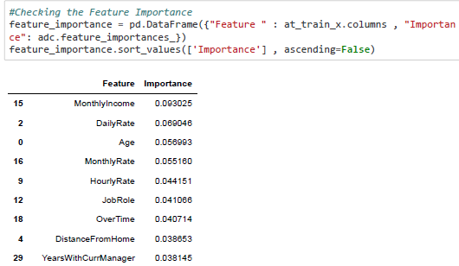
FEATURE SELECTION
Process wherein those features are selected, which contribute most to the prediction variable or output. Benefits of feature selection :
Improve the performance
Improves Accuracy Providing the better understanding of Data

Slide 33
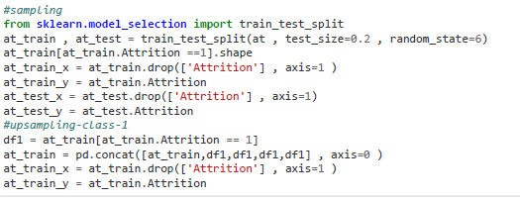
TRAINING DATA AND TESTING DATASET
Splitting data into train and test
The process of modeling means training a machine learning algorithm to predict the labels from the features

Slide 34
ABOUT RANDOM FOREST ALGORITHM
"Random Forest is a classifier that contains a number of decision trees on various subsets of the given dataset and takes the average to improve the predictive accuracy of that dataset." Instead of relying on one decision tree, the random forest takes the prediction from each tree and based on the majority votes of predictions, and it predicts the final output.
The greater number of trees in the forest leads to higher accuracy and prevents the problem of overfitting.
It can perform as both classifier and regression

Slide 35
ALGORITHM WE USED:
For the prediction purpose definitely we need algorithm model where there we starts to train test and scale our model to make use of RANDOM FOREST algorithm where it gives us 82% accuracy of employee attrition data so, here we can conclude that 82% of people where good employee having chance to leave company by this accuracy a company or companies HR can take prior action based on our prediction to avoid losing of good and talented employees attrition.
The Random forest works on the Bagging principle; it is an ensemble of Decision Trees. The bagging method is used to increase the overall results by combining weak models. How does it combine the results? In the case of classification problem, it takes the mode of the classes, predicted in the bagging process.

Slide 36
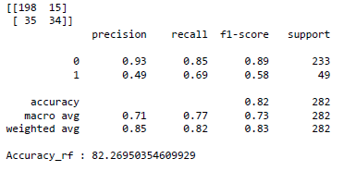
RESULT OUTPUT
ACCURACY SCORE, CLASSIFICATION REPORT, CONFUSION MATRIX

Slide 37
RESULT GENERATED VIA VISUALIZATION
Now we have our dataset with our current employees and their probability of leaving the company. If we were the HR manager of the company, we would require a dashboard in which we could see what to expect regarding future attrition and, hence, adopt the correct strategy to retain the most talented employees.
Analysis on percentage of predicted attrition, analysis by gender, business travel, department, salary hike or by distance from home. You can also drill down to see the employees aggregated in each of these analyses. As a quick conclusion, male employees who travel frequently, work at HR department, have a low salary hike, and live far from workplace have a high probability of leaving the company.

Slide 38
RECOMMENDATION
Transportation should be provided to employees living in the same area, or else transportation allowance should be provided.
Plan and allocate projects in such a way to avoid the use of overtime.
Employees who hit their two-year anniversary should be identified as potentially having a higher-risk of leaving.
Gather information on industry benchmarks to determine if the company is providing competitive wages.

Slide 39
CONCLUSION:
EMPLOYEE ATTRITION AND PERFORMANCES using Exploratory Data Analysis is used to visualize the employee attrition problem and to look close over it to get and to choose the best model with good accuracy score to predict the human attrition and finally we use Random forest with ada booster and Random forest. Therefore we got the random forest with 82% accuracy score in random forest ada booster algorithm is the best suitable one.

Slide 40
REFERENCE’S
Setiawan*, S Suprihanto, A C Nugraha and J Hutahaean Department of Computer Engineering and Informatics, Politeknik Negeri Bandung, Bandung, Indonesia (2018) HR analytics: Employee attrition analysis using logistic regression
Lohela-Karlsson M, Hagberg J and Bergström G 2015 Production loss among employees perceiving work environment problems International archives of occupational and environmental health.
Sri Harsha, A. Jithendra Varaprasad, L.V N Pavan Sai Sujith (2020) EARLY PREDICTION OF EMPLOYEE ATTRITIONINTERNATIONAL JOURNAL OF SCIENTIFIC & TECHNOLOGY RESEARCH VOLUME 9, ISSUE 03.
Ali, Omar, and Nur Zuhan Munauwarah. "Factors affecting employee turnover in organization/Nur Zuhan Munauwarah Omar Ali." (2017).
Devi, P. Saranya, and B. Umadevi. "A Novel Approach to Control the Employee‟s Attrition Rate of an Organization." (2018).
Frederiksen, Anders. "Job Satisfaction and Employee Turnover: A firm-level perspective." German Journal of Human Resource Management 31.2 (2017):

Slide 41
REFERENCE’S
Devi, P. Saranya, and B. Umadevi. "A Novel Approach to Control the Employee’s Attrition Rate of an Organization." (2018).
Frederiksen, Anders. "Job Satisfaction and Employee Turnover: A firm-level perspective." German Journal of Human Resource Management 31.2 (2017)
MEDIUM FOR EMPLOYEE ATTRITION https://medium.com/swlh/exploratory-data-analysis-employee-attrition-rate-591ce8e7518f

